Slide 1

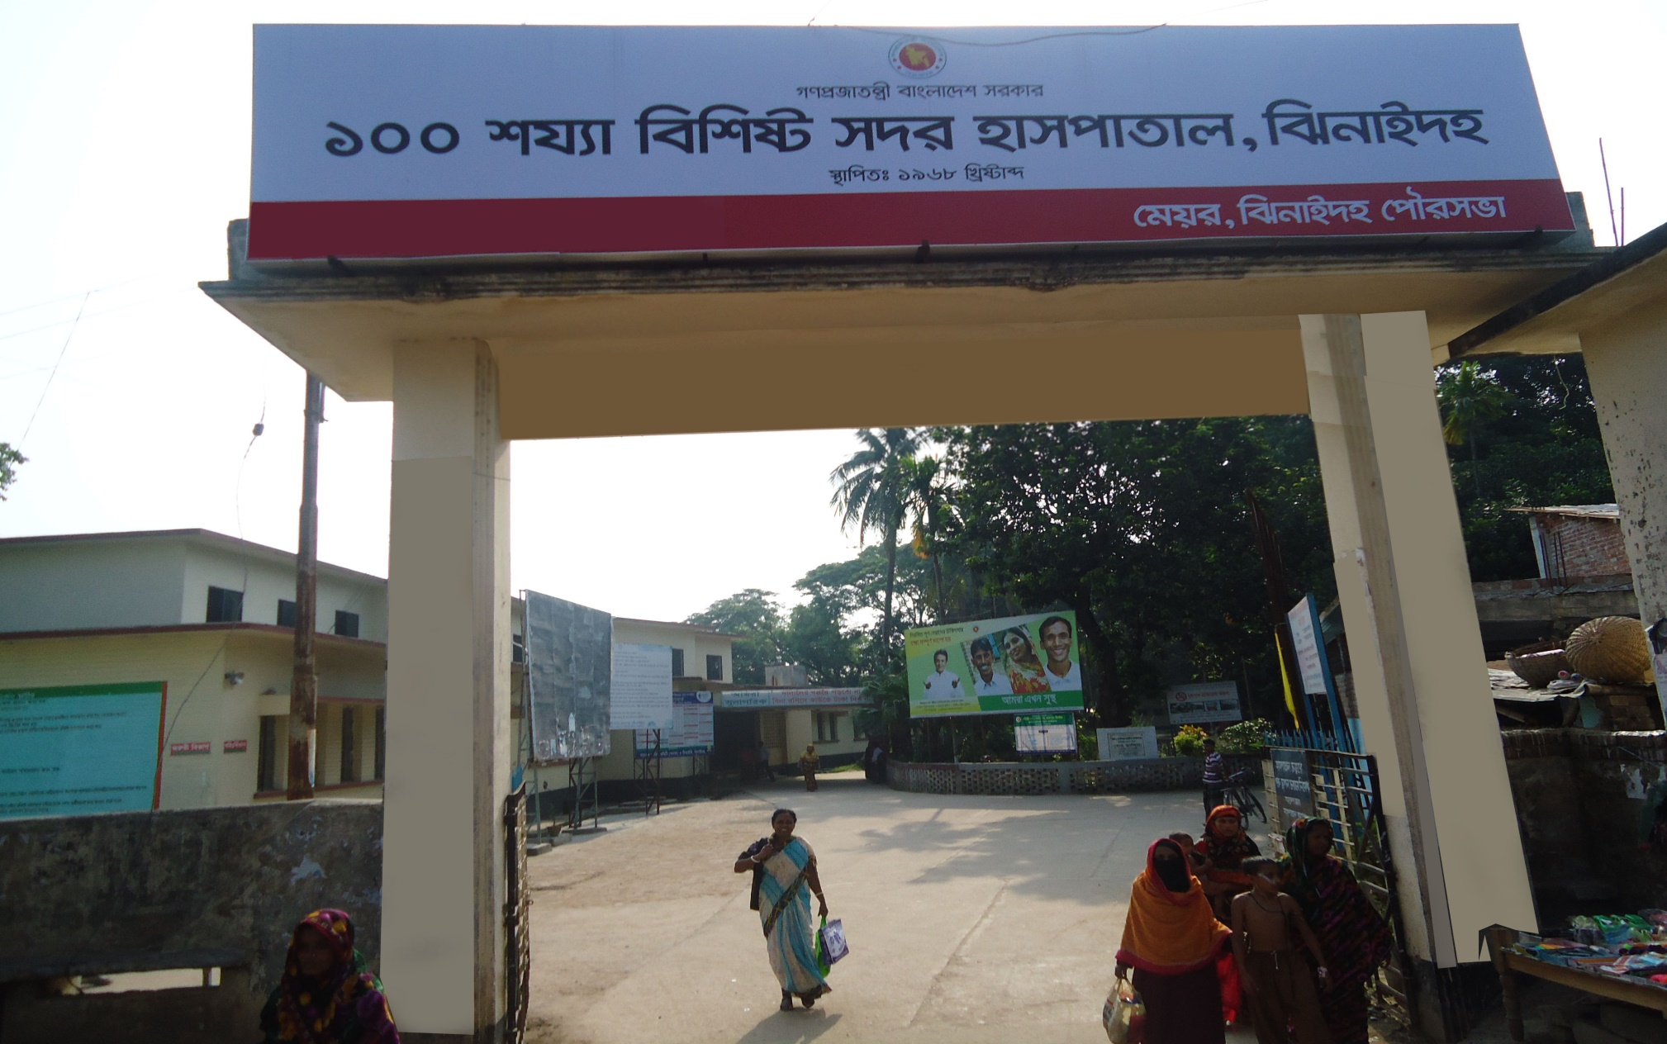
5S-CQI-TQM in Jhenaidah Sadar Hospital
Dr. Md.Emdadul Haque
Senior Consultant (Obst & Gynae)

Slide 2

Sadar Hospital, Jhenaidah
Bed Occupancy Rate from 1998 to 2015
Sl. No | Year | Bed Occupancy Rate
01 | 1998 | 126%
02 | 2011 | 146%
03 | 2013 | 165%
04 | 2015 | 193%

Slide 3

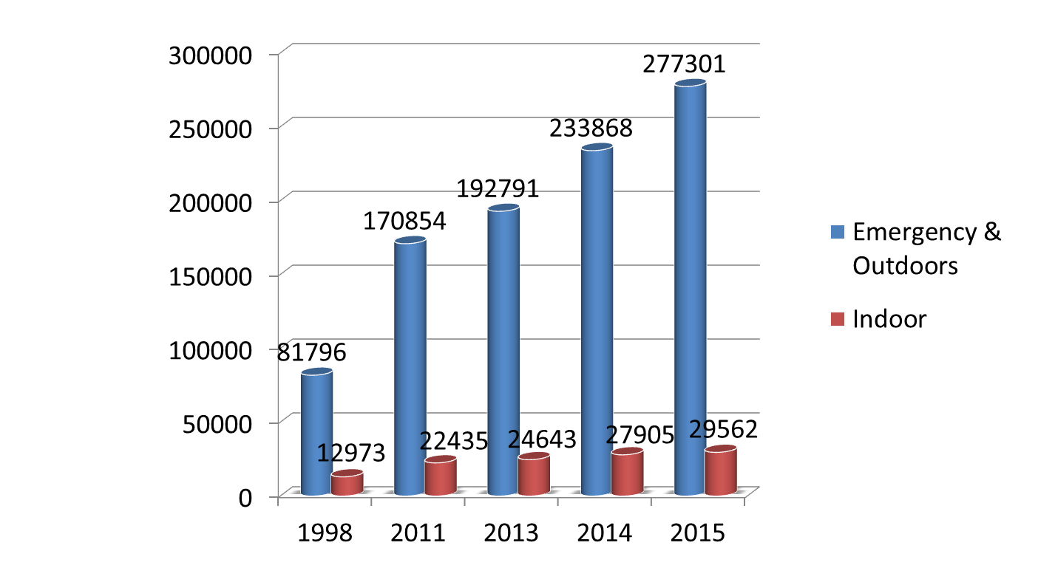
Emergency & Out Door, Indoor Service 1998 to 2015
Sadar Hospital, Jhenaidah

Slide 4

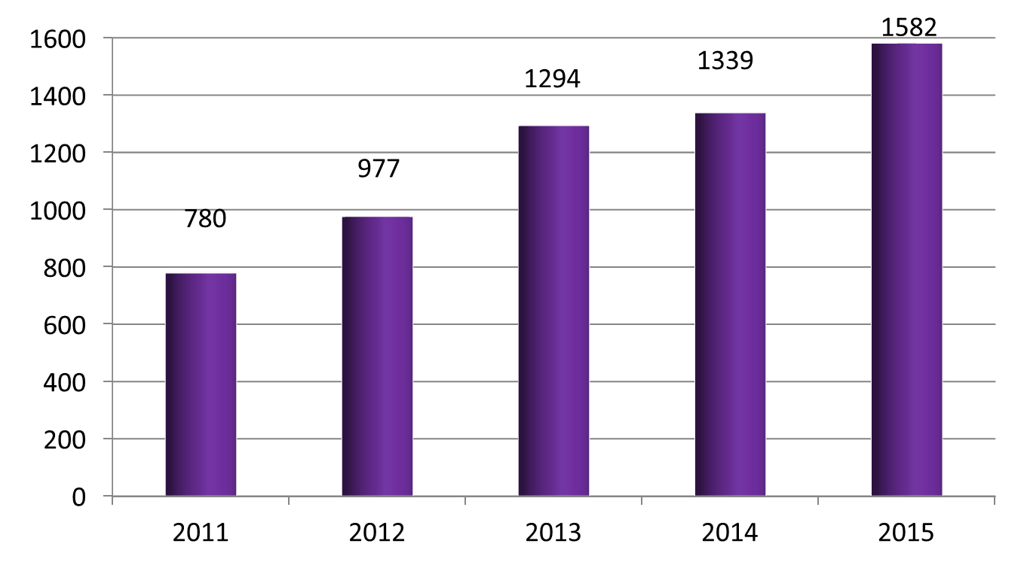
Operation Service (Major) 2011 to 2015
Sadar Hospital, Jhenaidah

Slide 5
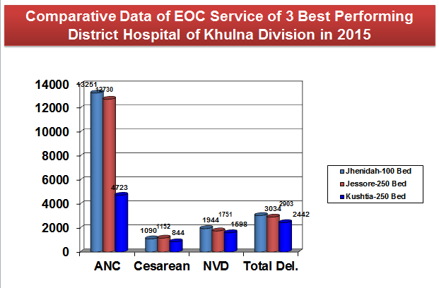
Sadar Hospital, Jhenaidah

Slide 6
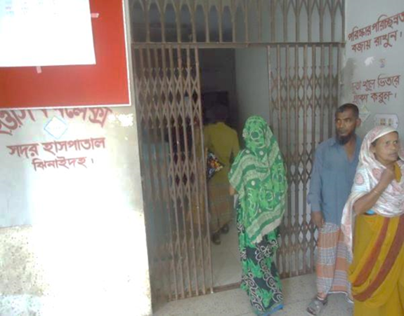
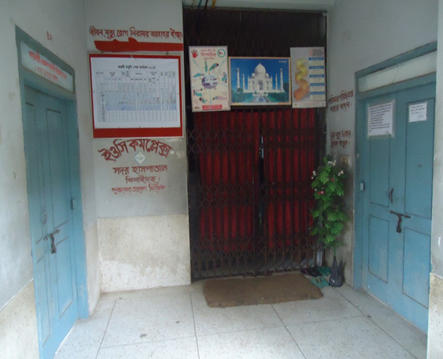
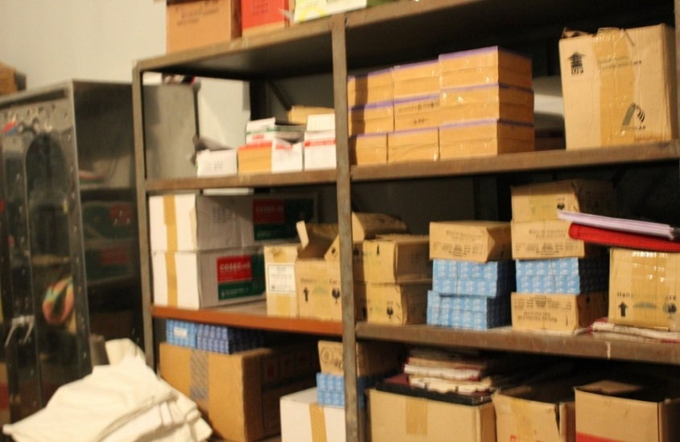
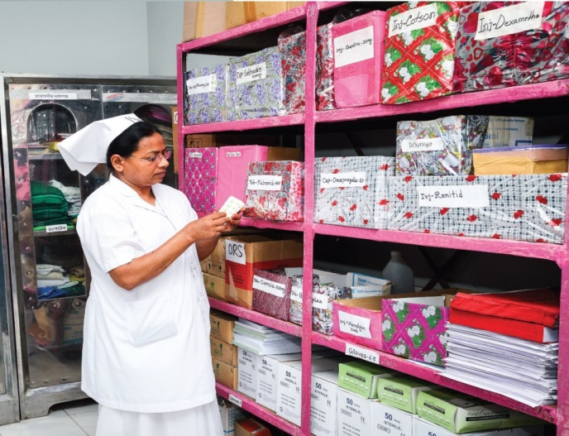
Changes in EOC Ward
Before
After
Before
After

Slide 7


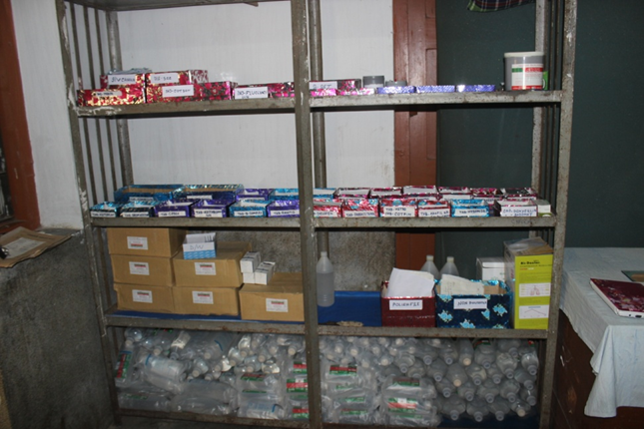
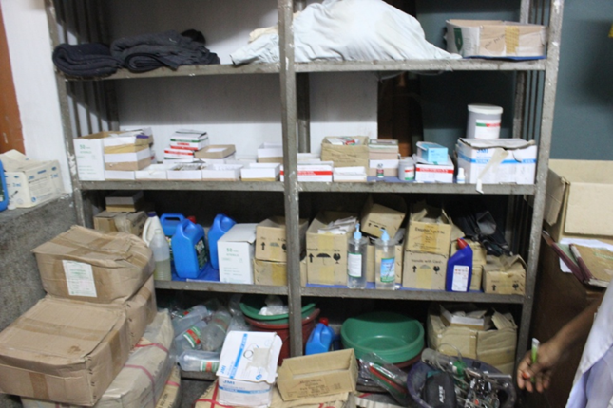

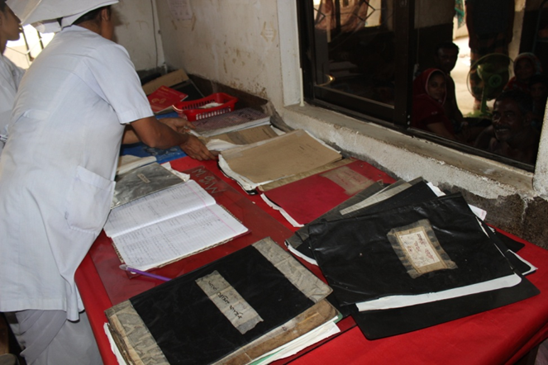
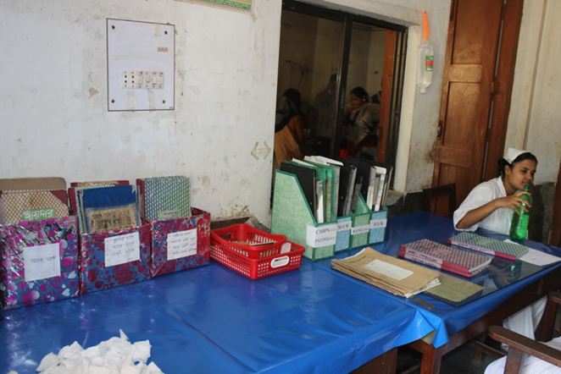

Changes in Surgery Ward

Slide 8
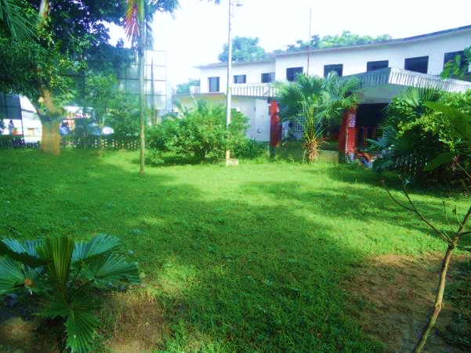
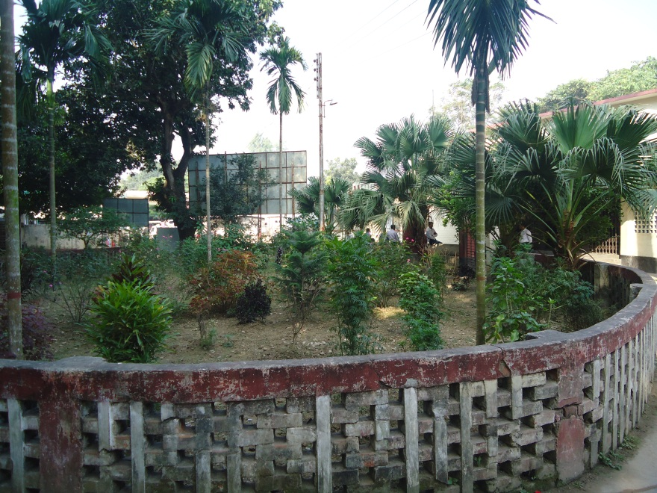
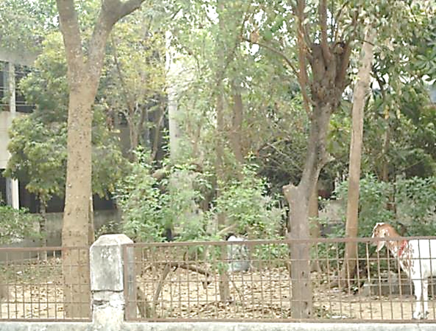
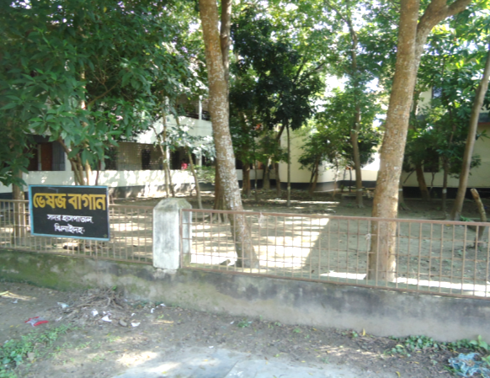
Changes in Gardens of The Hospital
Before
After
Before
After

Slide 9
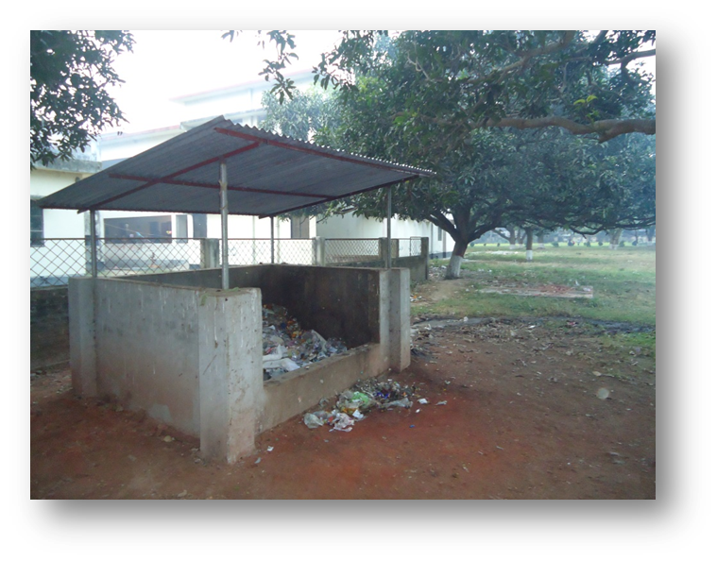
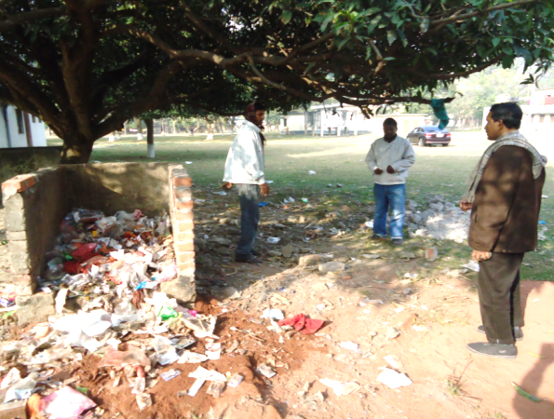
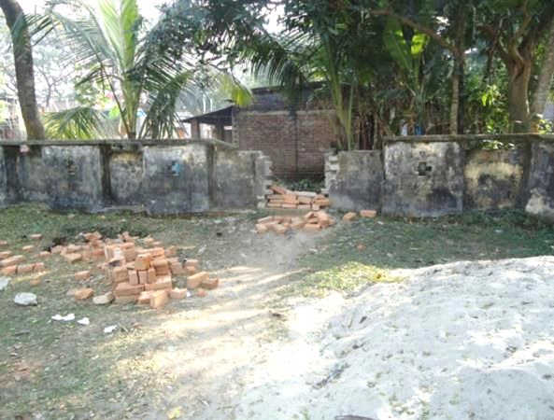
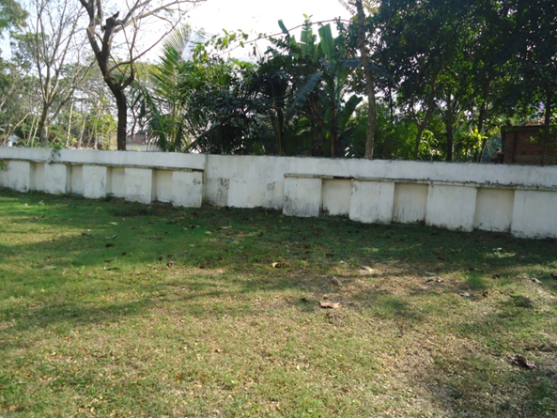
West Management & Campus Protection
Before
After
Before
After

Slide 10
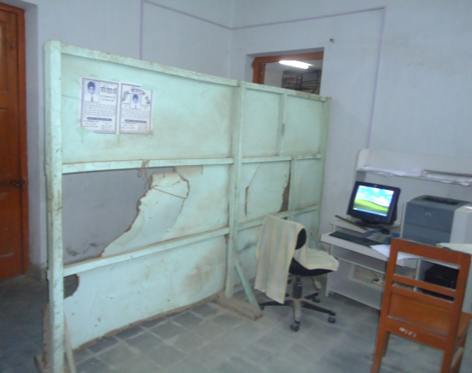
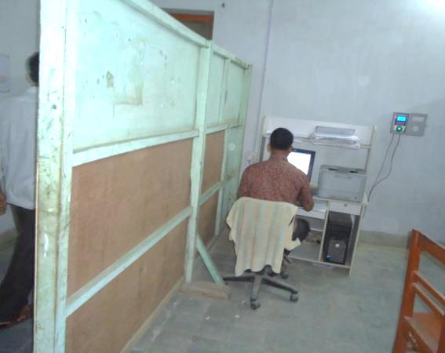
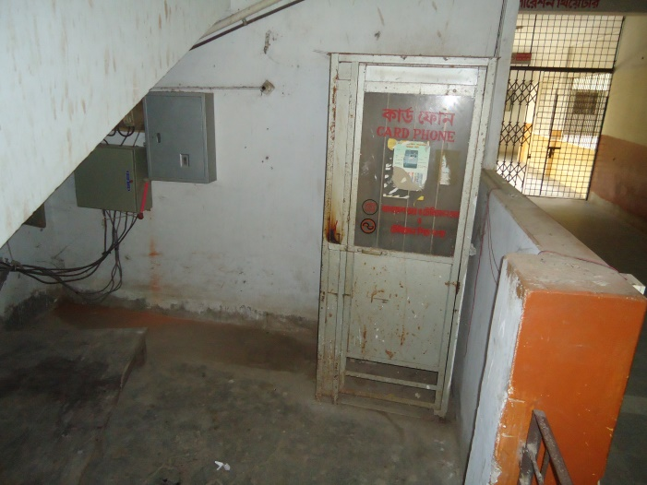
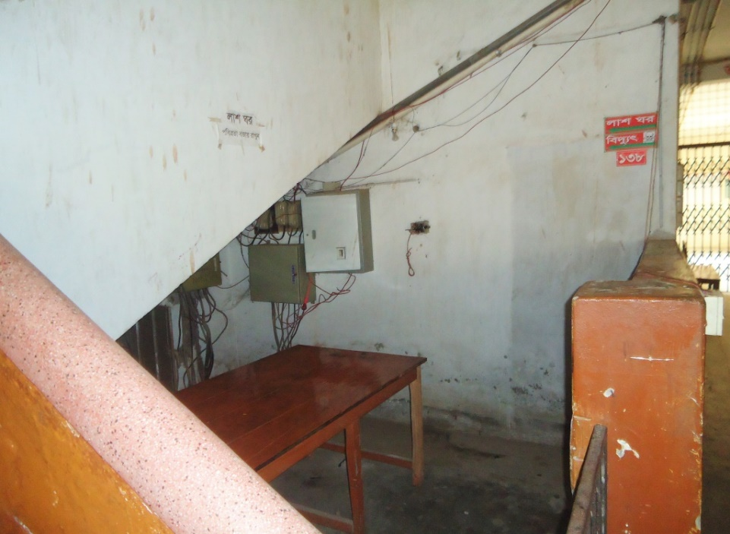
Changes in Office and Hospital Internal Environment
Before
After
Before
After

Slide 11
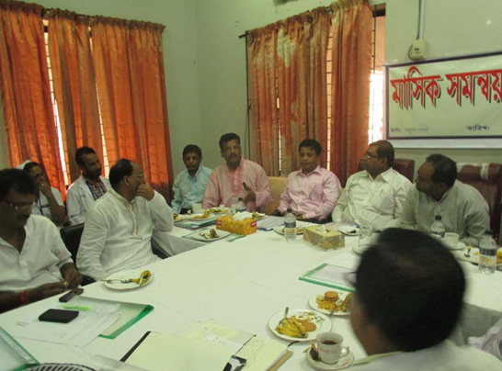
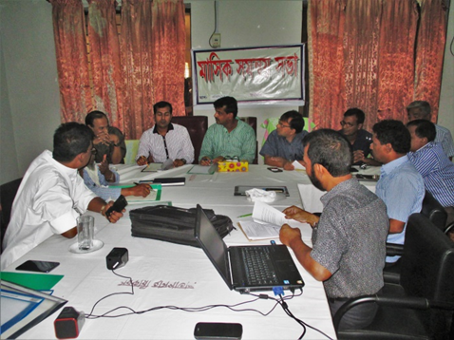
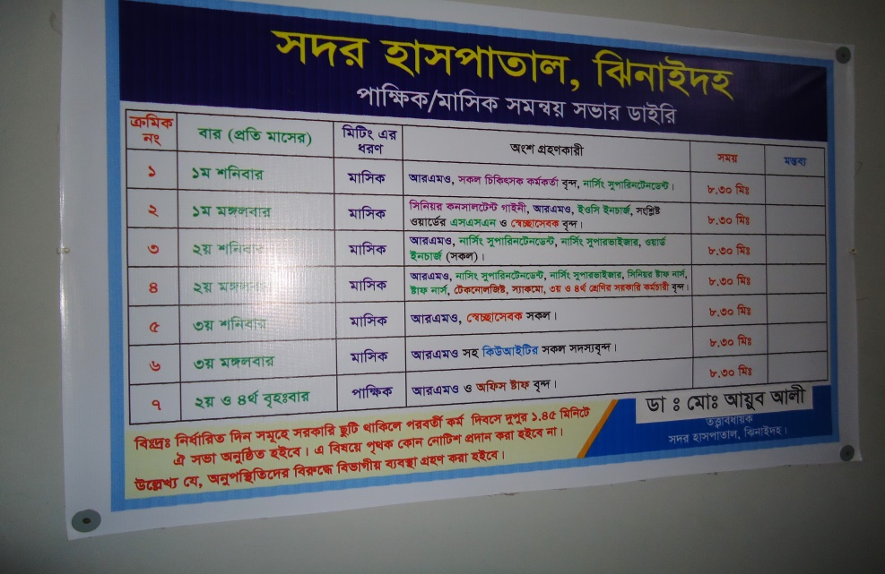
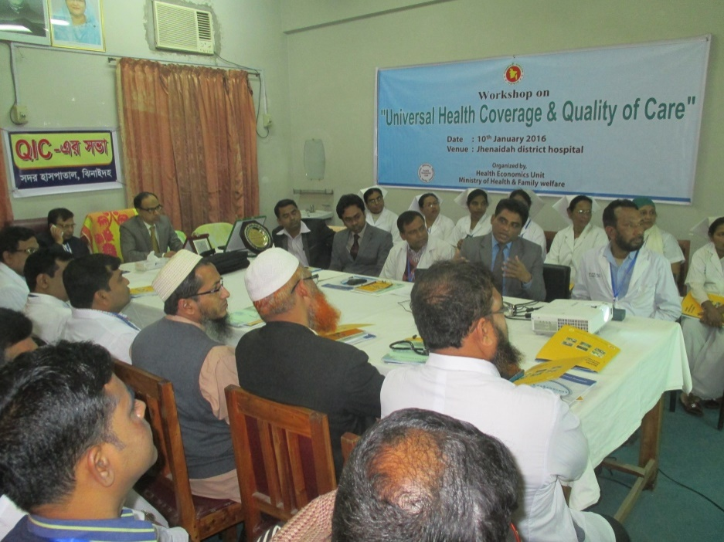
Internal Monitoring System
Meting of health improvement committee
Meting of community support group committee
Monthly meeting schedule
QIC meeting

Slide 12
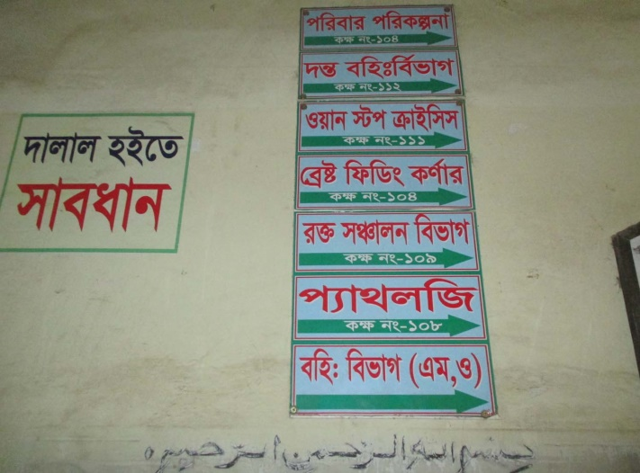
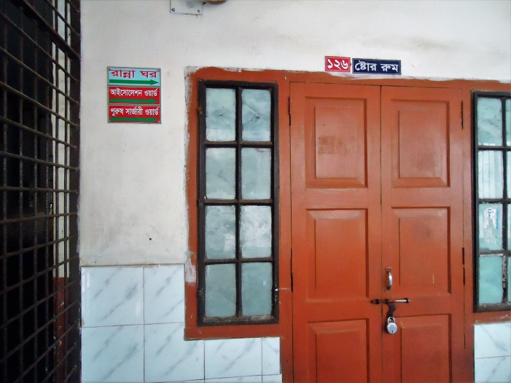
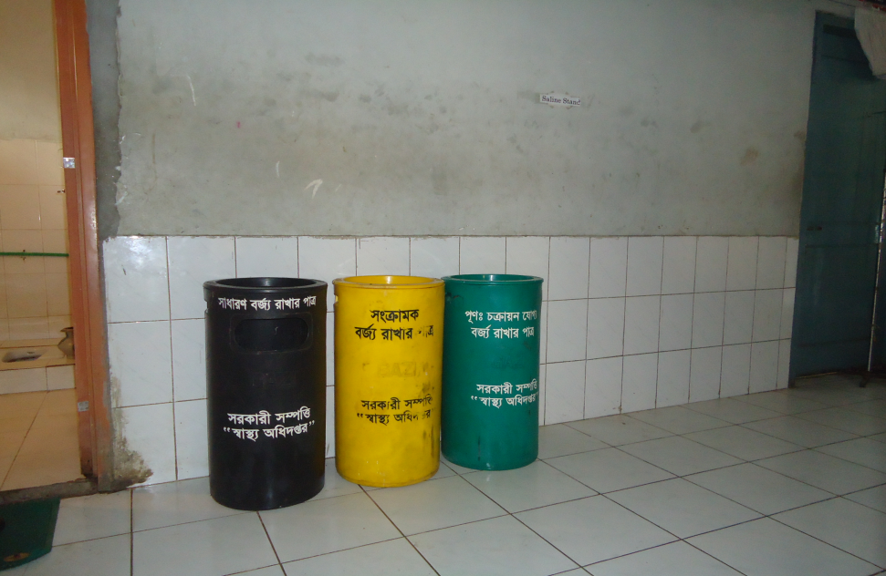
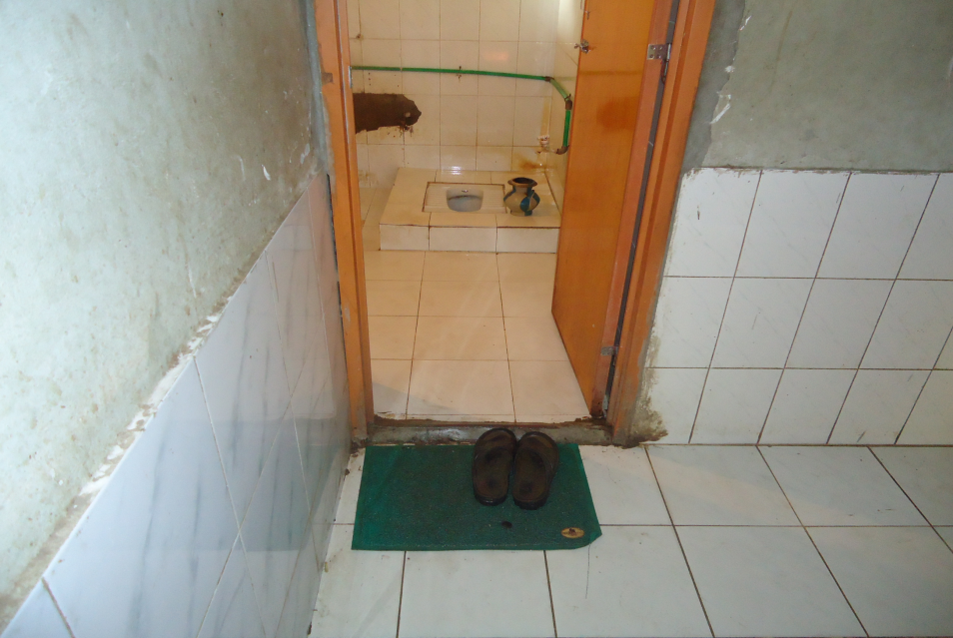
Use of direction sign, labeling of rooms, clean latrine and waist segregation
Use of direction sign
Labeling of rooms
waist segregation
Clean latrine

Slide 13
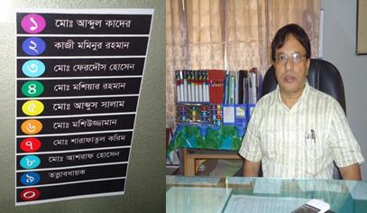
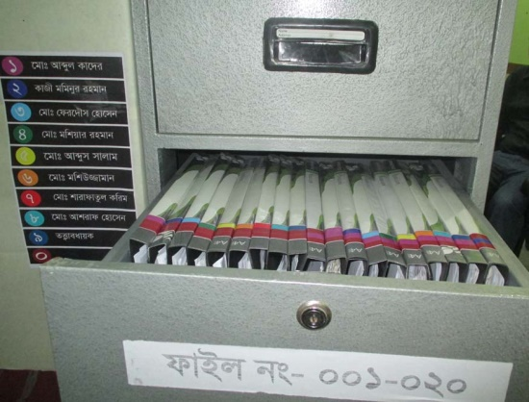
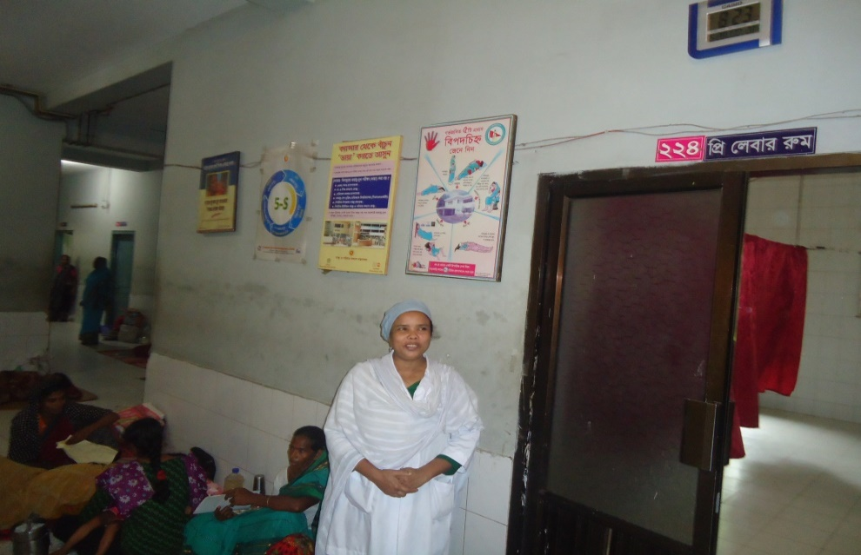
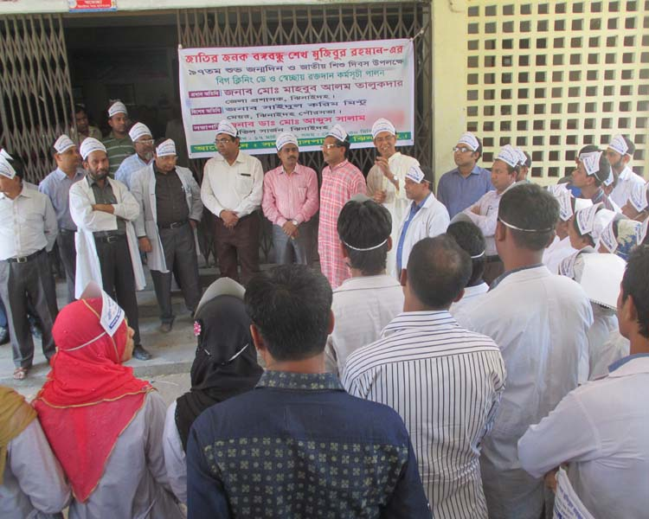
Use of color code, alignment of picture & continuous big cleaning day
Color code
Color code
Alignment of pictures
Big cleaning day
Girls guide for lining of patients

Slide 14
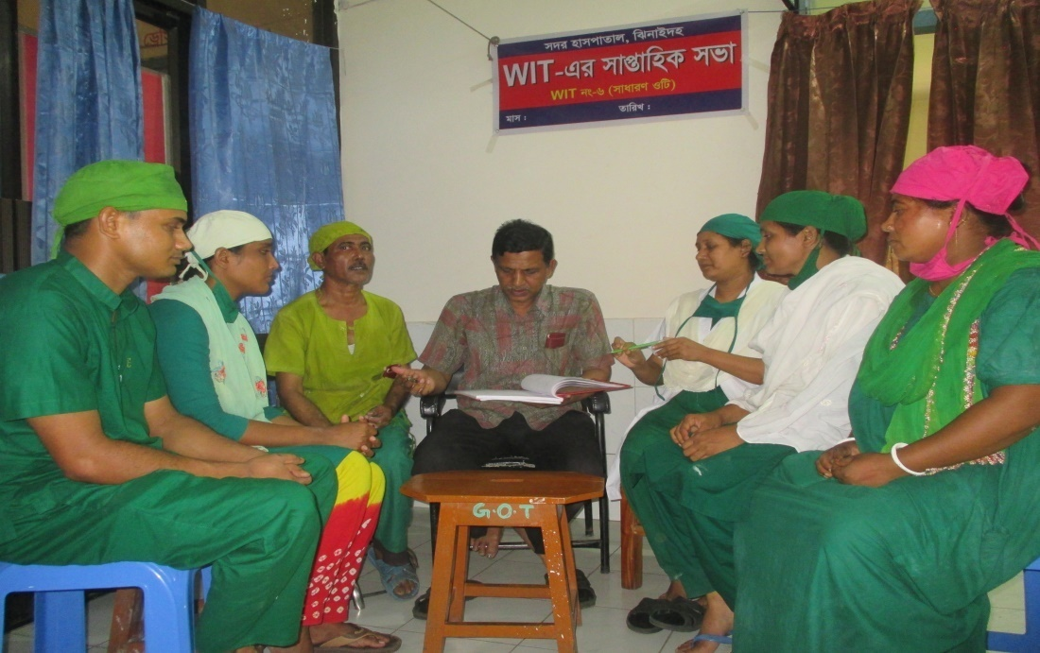
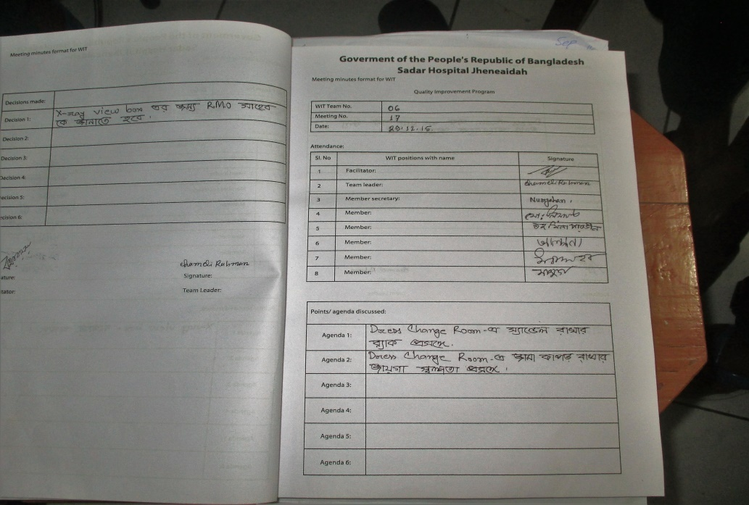
Activities of the best WIT
WIT No: 06(GOT) :
Facilitator: Dr. A Rahman
Team Leader: Chameli Rahman(SSN)
Member Secretary: Nur Jahan (SSN)
Achievements:
Regular meeting (100%).
Improved cleanliness & infection control system.
Improved performance.
Installation of new AC, X-Ray view box, pulse oxi-meter.

Slide 15
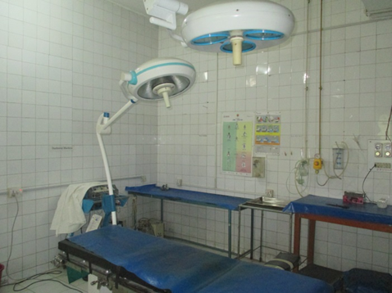
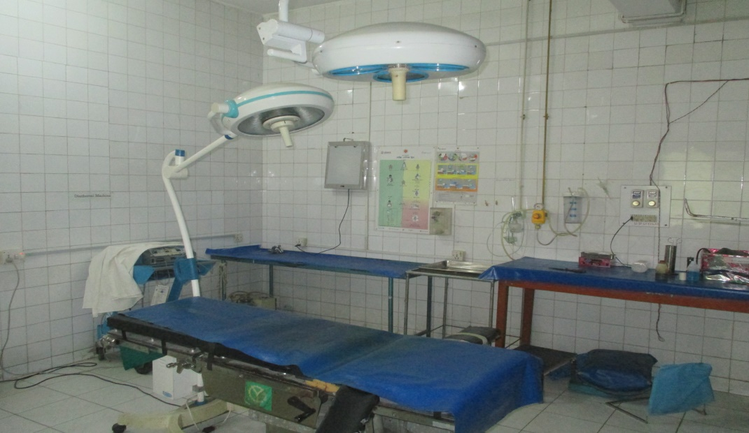
Small Kaizen activity
Section.: OT (WIT-3); Team leader: Chameli Begum Date of implementation: 20 March, 2016
Before CQI | After CQI
1. Problem: Surgeons are often confused about the x-ray findings during orthopedic operation. Due to lack of x-ray view box on the wall. | 1. Benefits: Surgeons can easily identify the problems by hanging x-ray view box on the wall.
2. CQI points/solution: Hanging of a x-ray view box on the operation theater wall.
3. Inputs: X-ray view box and some hangers.

Slide 16
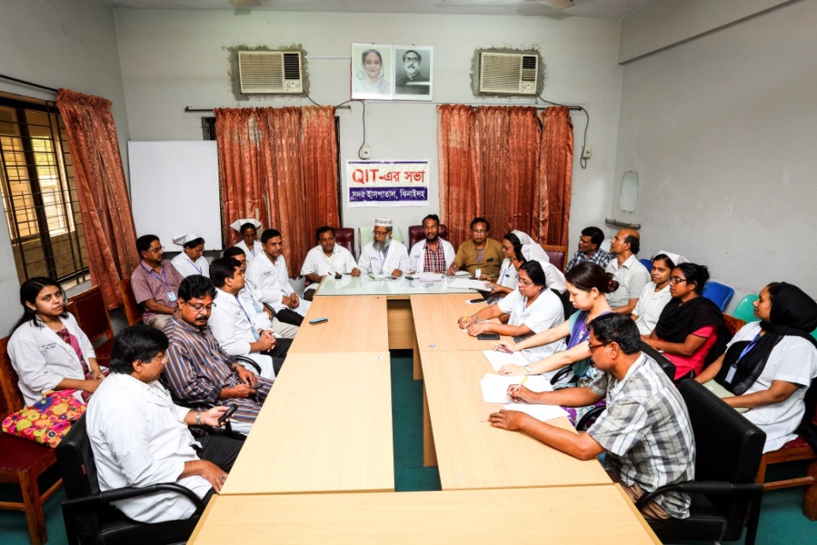
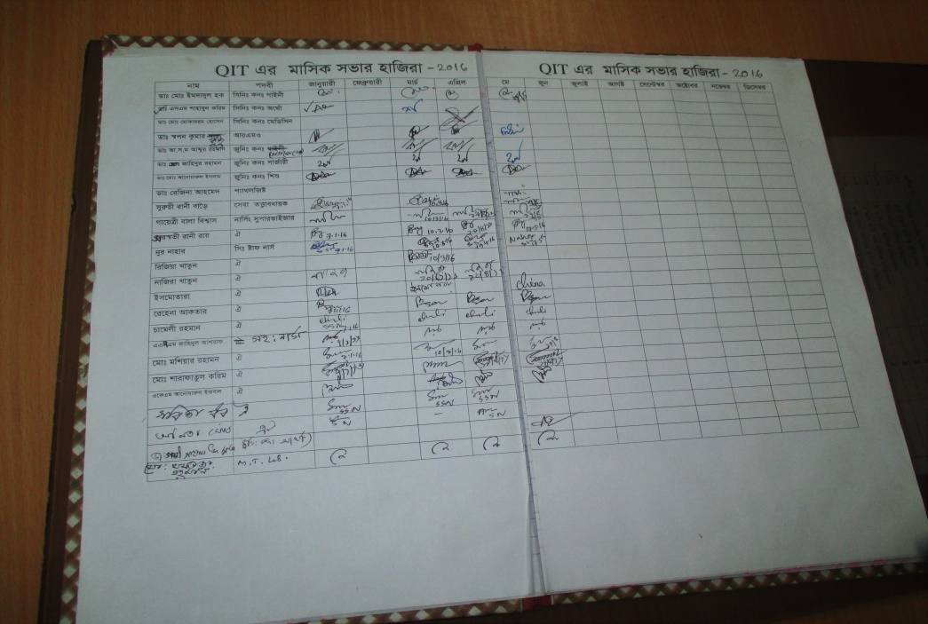
Activities of Quality Improvement Committee
President, Hospital Super.
Member Secretary: RMO
Focal Person: Senior Consultant
(Obs. & Gynae)
Total Number of WIT: 12
Number of meeting: 04(Jan to May)
Major Actions Implemented:
Improved pediatric word with NICU.
Improved emergency section.
Continue of X-ray service by public social welfare partnership.
Improved infection control system
Repairing all essential equipment.
QIC meeting
Resolution of QIC meeting

Slide 17
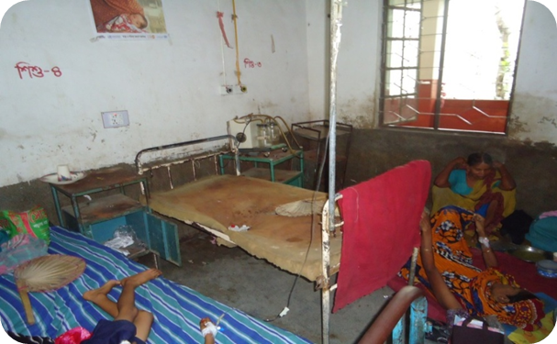
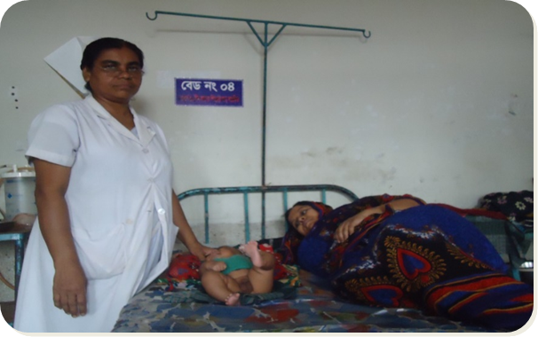
CQI activities
Section: Pediatric Word; WIT No. 12 Facilitator : Consultant (Pad) Date of implementation: February, 2016 Team leader: Sobita Dhor(SSN)
Before CQI | After CQI
1. Problem: Pediatric patient were uncared because of pediatric and female medicine word were in a single place. | 1. Benefits: Established a separate pediatric word so special attention is possible for the patients
2. CQI points/solution: Single set of staffs managed whole pediatric and female patients. The area was congested and so the pediatric patients suffers more. | Separation and shift the word in another place with full staff support. The pediatric and neo nets get special benefits.
3. Inputs: The new pediatric area was full of unused materials. | Arrange human resource, logistic support and established a neo natal care unit.

Slide 18
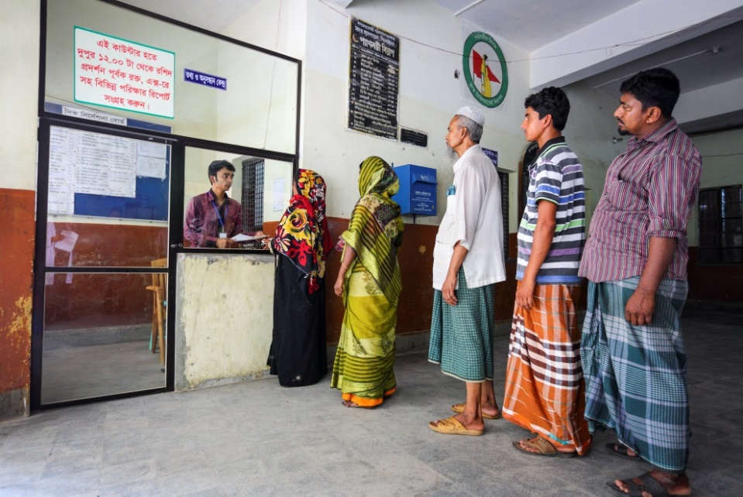
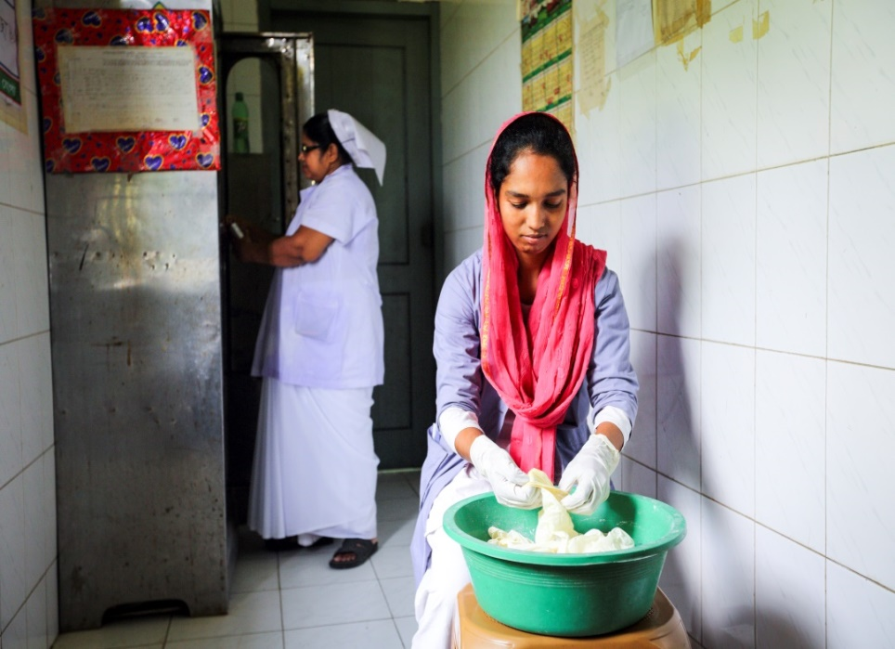
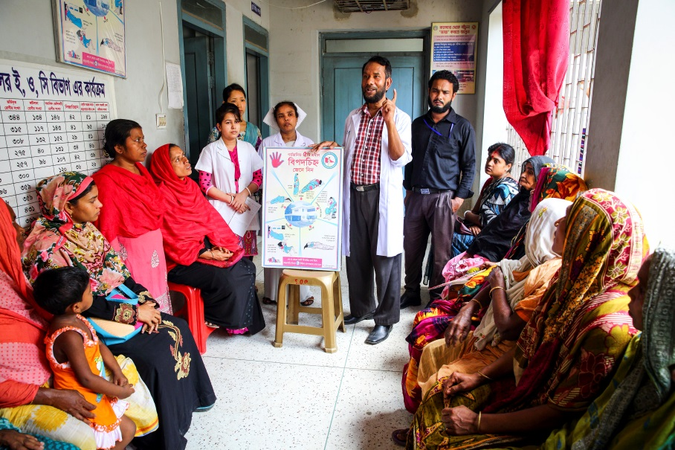
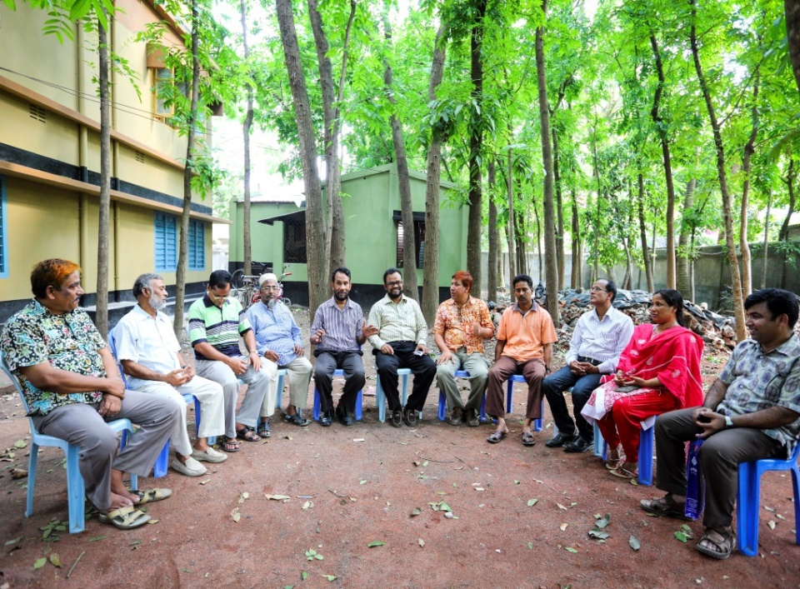
Innovative activities of Jhenaidah Sadar Hospital Page: 1
Reception room
Creation of nursing aid
Health education session
Community engagement

Slide 19
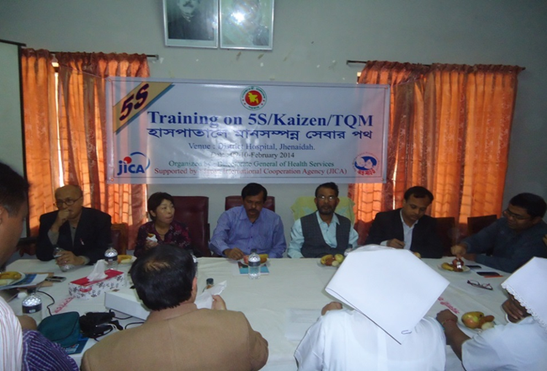
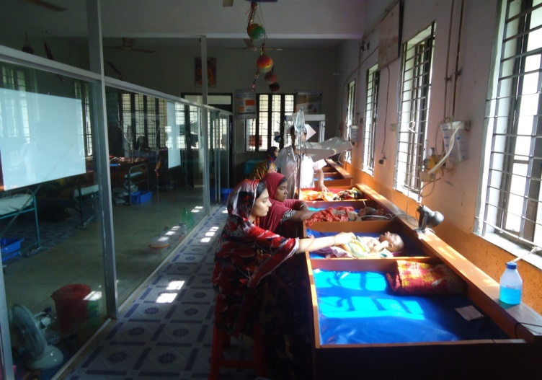


Innovative activities of Jhenaidah Sadar Hospital Page: 2
Starting of 5S KAIZEN-TQM
Neonatal Care Unit
Manobota
Big Cleaning Day

Slide 20



Innovative activities of Jhenaidah Sadar Hospital Page: 3
Community donated intercom
Community Supported Manpower

Slide 21



Improved pediatric word by local initiative

Slide 22




Hospital Environment

Slide 23
Future action plan for 2 months
Sl | Things to be improved | Where | How to do | When | Person responsible
1 | Improve infection control system | Emergency, labor room, ENT dental outdoor and surgery indoor | Using separate drum sterilizer and detergent | 20 to 30 June | RMO and Focal Person
2 | Display of statistics of last 3 years | Emergency, Male & Female, Medicine, surgery and pediatric word | By hanging display board | 25 June to 30 July | Facilitator, team leader of the respective WIT & statistician
3 | Established health education corner | Outdoor and every word | Arrange space in outdoor & indoor and making a poster of BCC | 15 June to 20 July | Focal Person, RMO, team leader, nursing supervisor

Slide 24

Thank You

